Slide 1
‘Once a Young Farmer, always a Young Farmer’:
Culture and identity in
Glarryford Young Farmers’ Club
Molly Goyer Gorman
PhD candidate, Queen’s University Belfast mgoyer01@qub.ac.uk www.mollygoyergorman.com

Slide 2
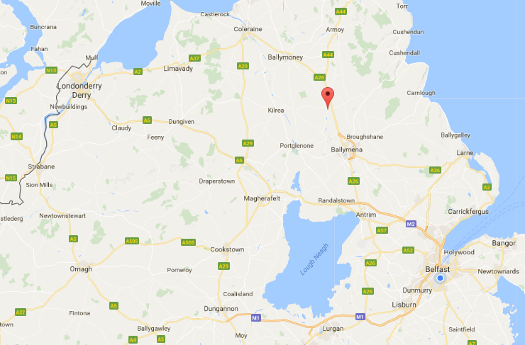
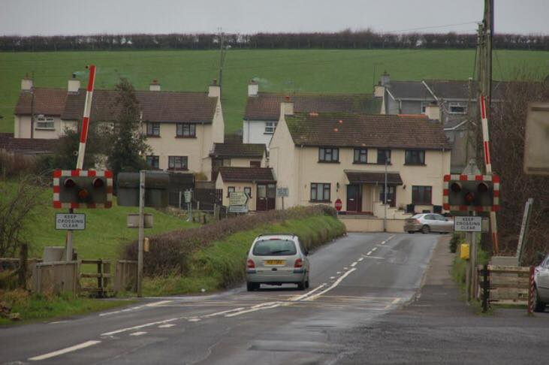
Glarryford
Glarryford Railway Crossing
Belfast

Slide 3
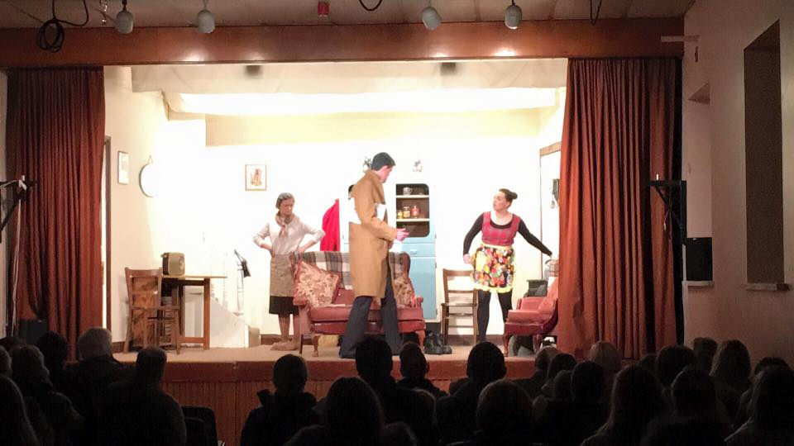
Performance of ‘Anyone Can Rob a Bank’ in Glarryford Young Farmers’ Hall

Slide 4
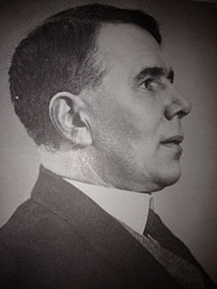
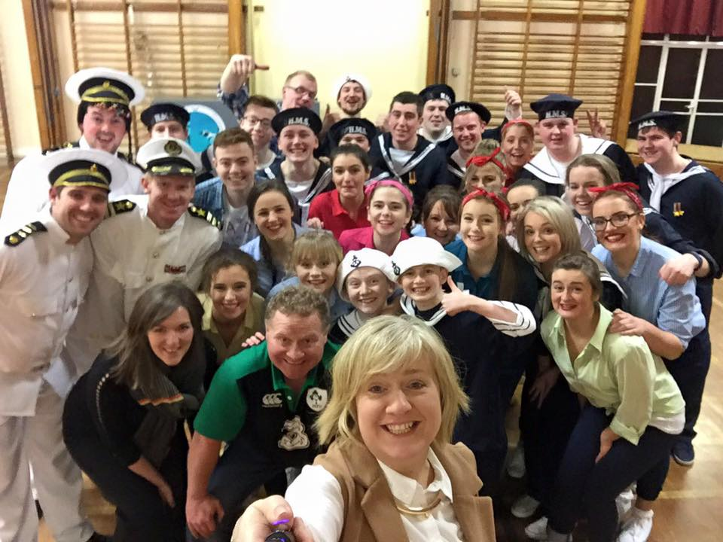

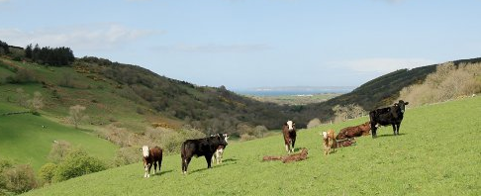

Slide 5
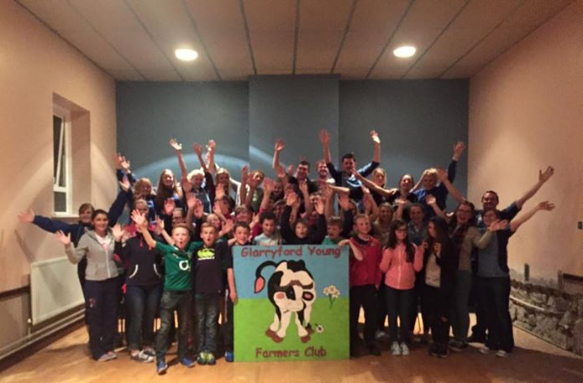

Slide 6
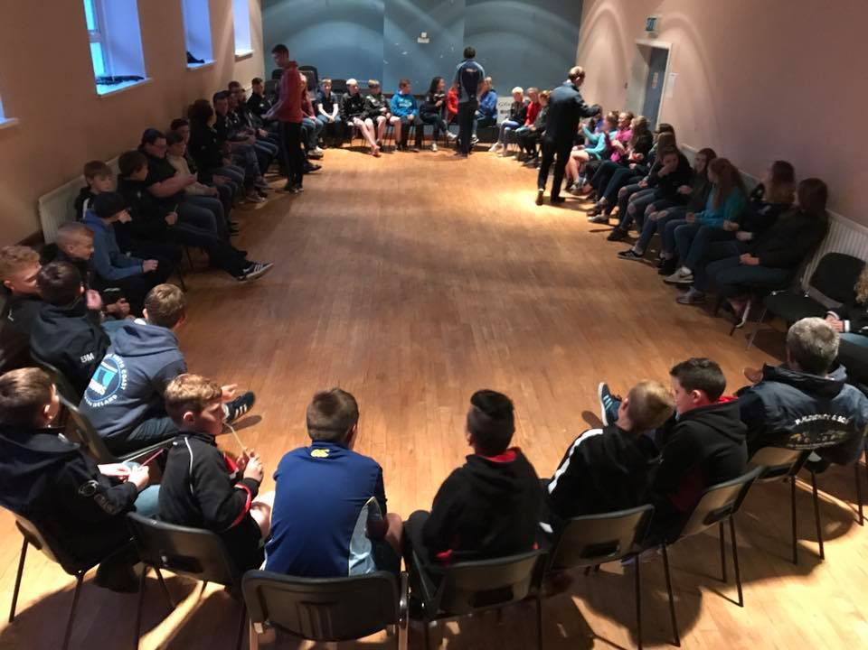
Junior members & new recruits at a
Glarryford Club meeting

Slide 7
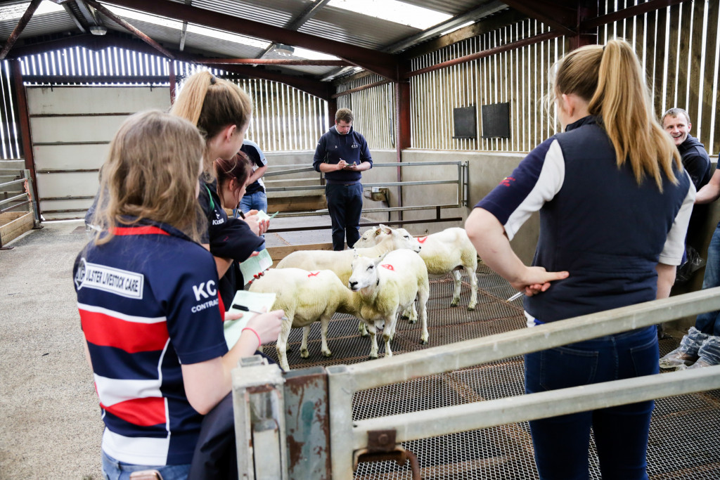
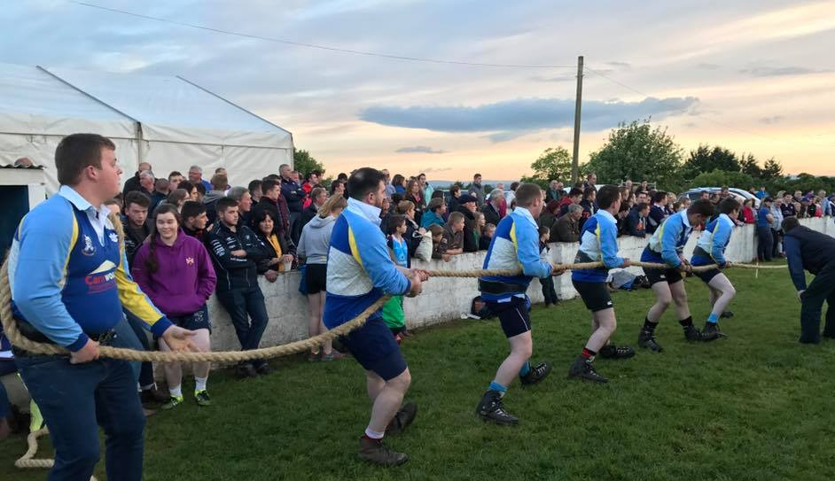
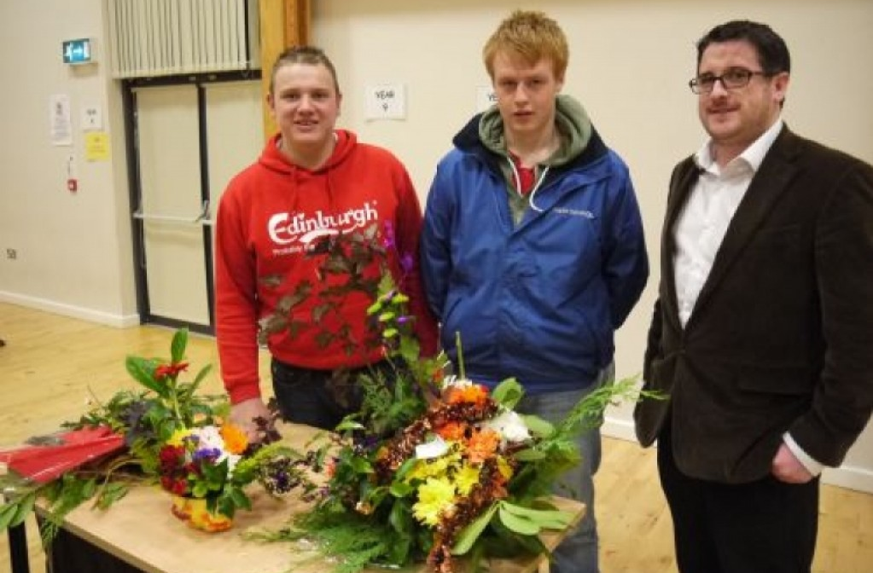
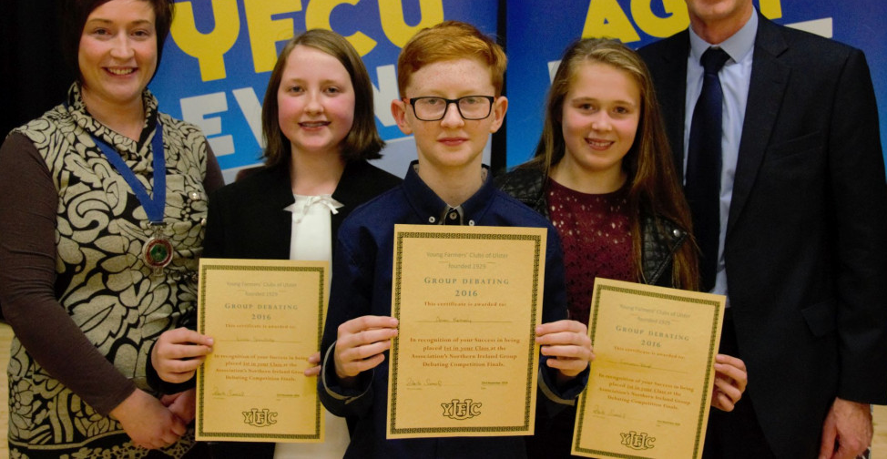

Slide 8
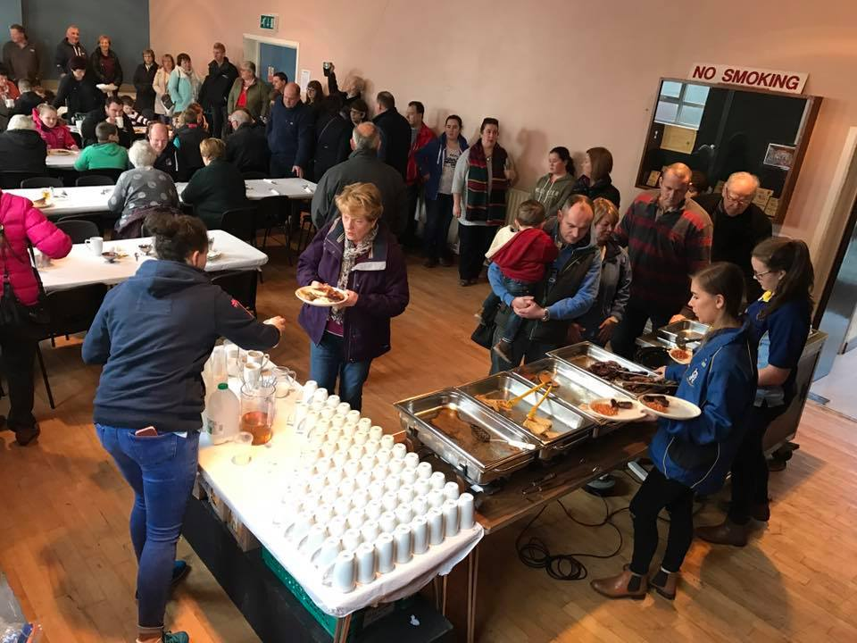
Glarryford YFC
‘Big Breakfast’: fundraising for local man’s cancer treatment

Slide 9
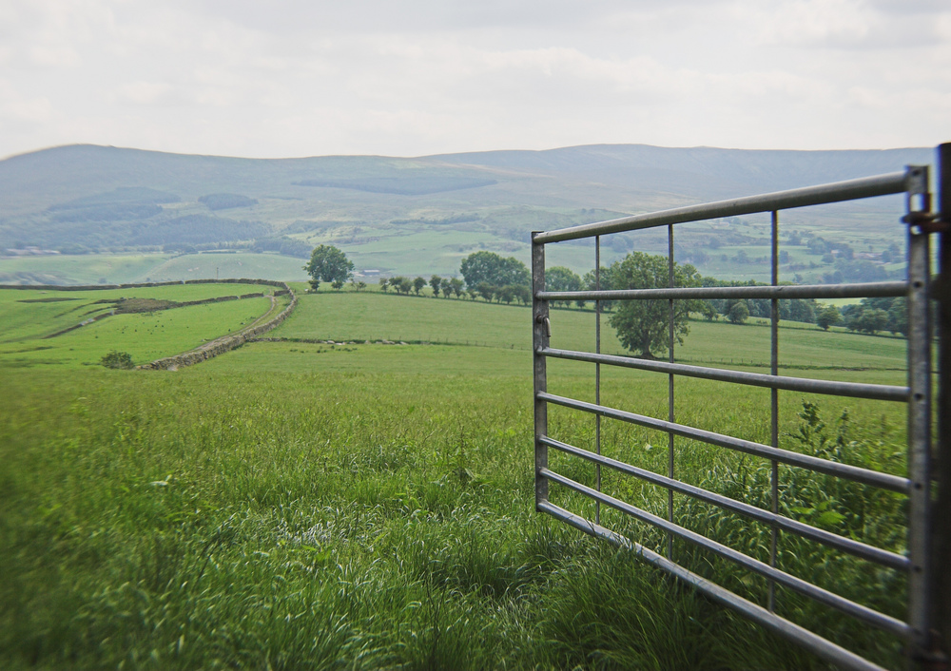

Slide 10
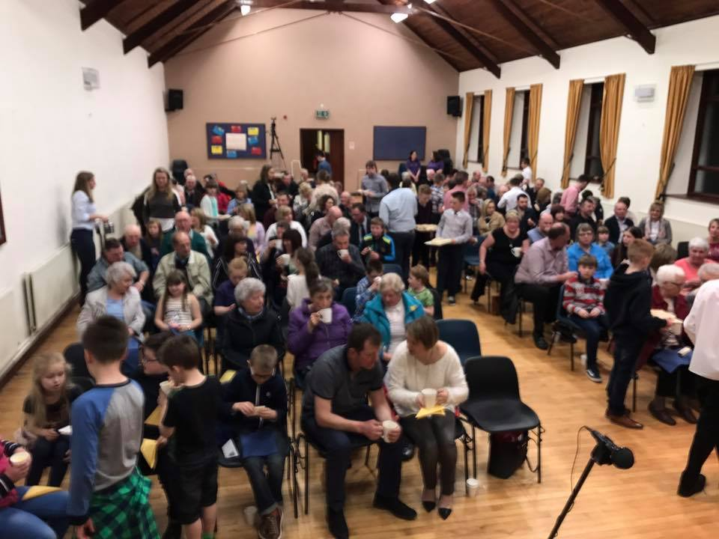
Glarryford YFC Parents’ and Friends’ Night 2017
Clough Presbyterian Church Hall

Slide 11


Slide 13
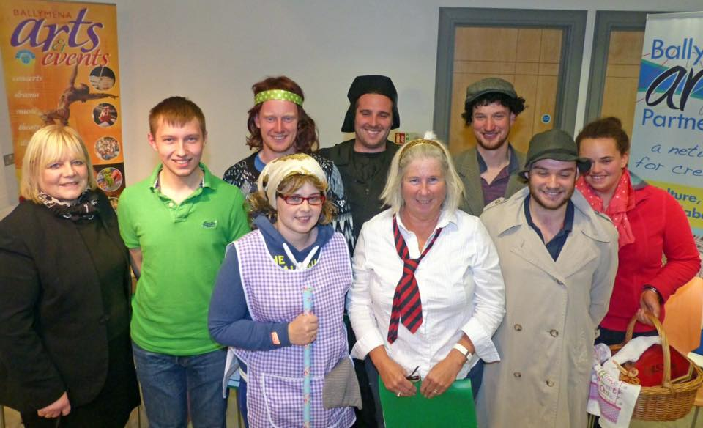
Joint sketch with Glarryford Club members and The Country Players

Slide 14
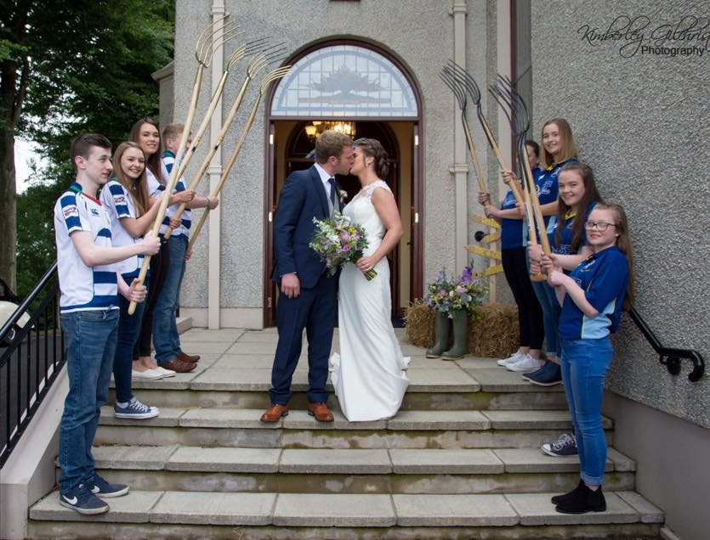

Slide 15
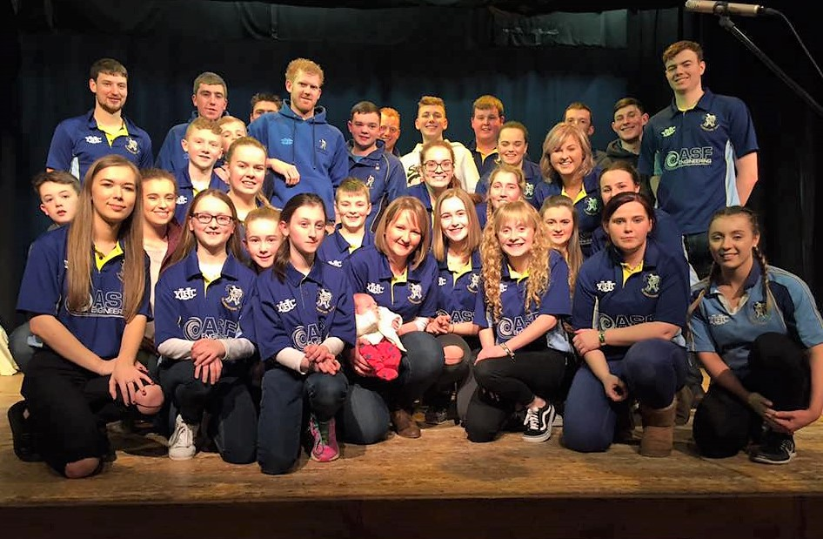
The latest recruit:
The Club with a member’s newborn baby

Slide 16
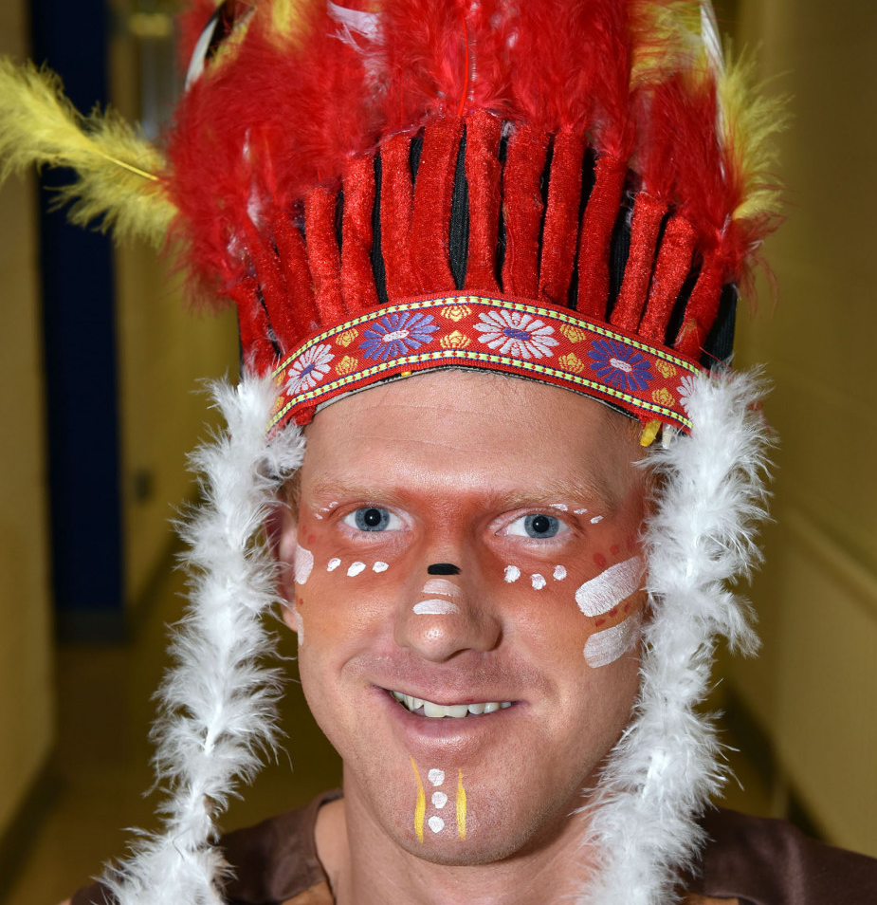
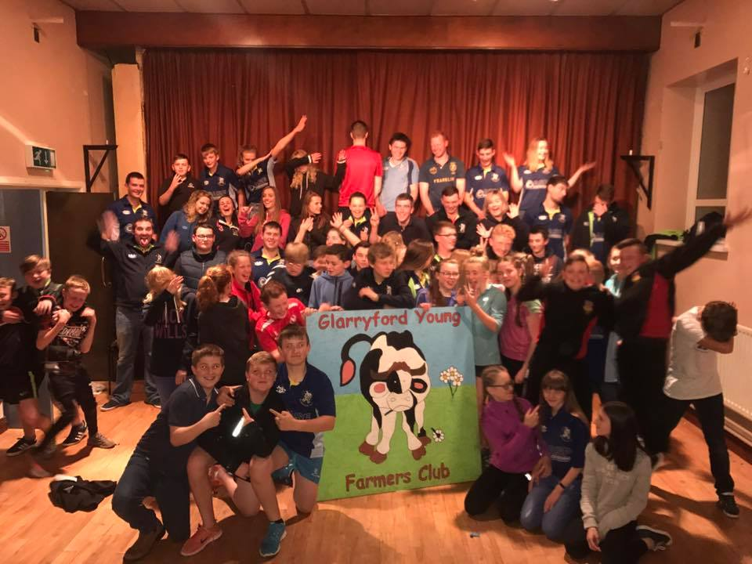
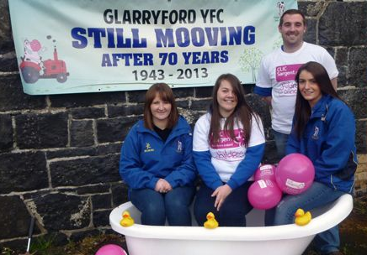

Slide 17
