Slide 1
Youth drama in Northern Ireland: theatre-making for the future
Molly Goyer Gorman
PhD candidate in Drama, Queen’s University Belfast mgoyer01@qub.ac.uk www.mollygoyergorman.com

Slide 2
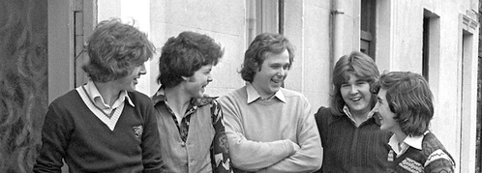
Lord Peter Melchett M.P. (age 29),
speaking with young men in East Belfast, 1977

Slide 3
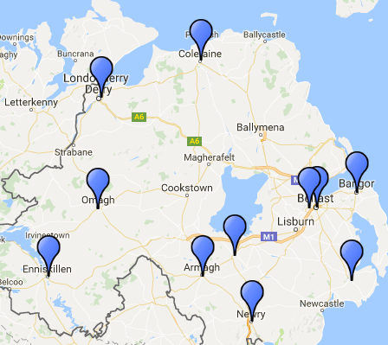

Locations of 11 of the 13 Arts Council-funded groups

Slide 4
Ulster Youth Theatre participants in 1985 and 1986

Slide 5
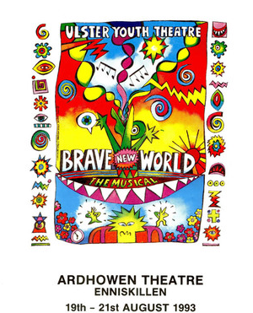
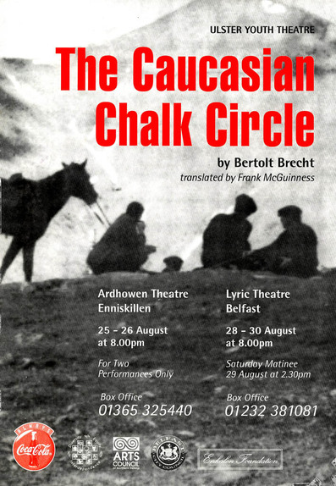

Slide 6


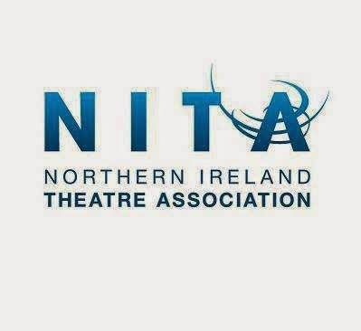
Merged in 2015 to become…

Slide 7
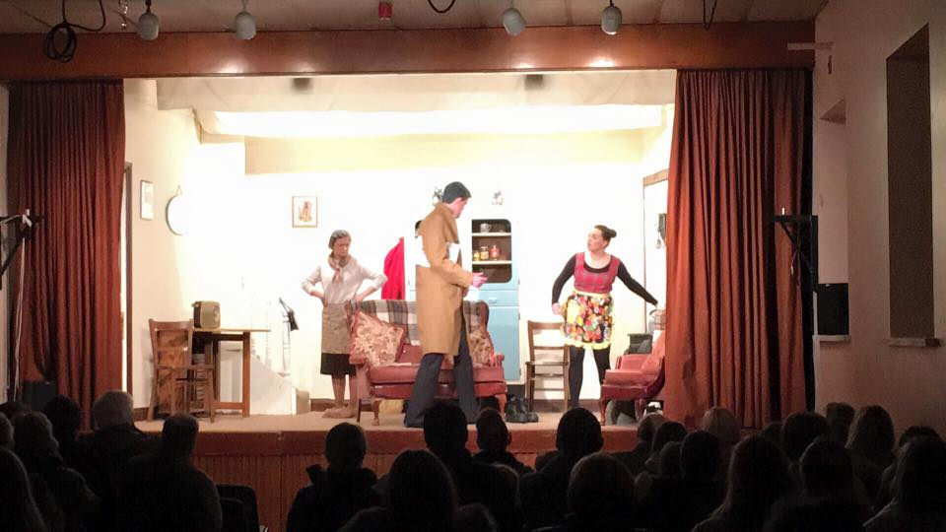
Glarryford YFC, winners of the 2016
Young Farmers’ Clubs Drama Festival

Slide 8
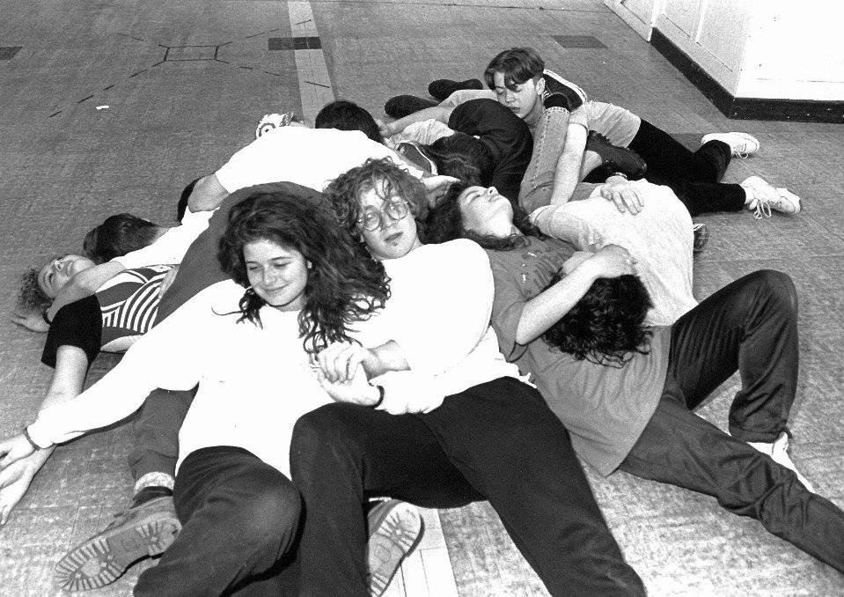
Ulster Youth Theatre
1993

Slide 9
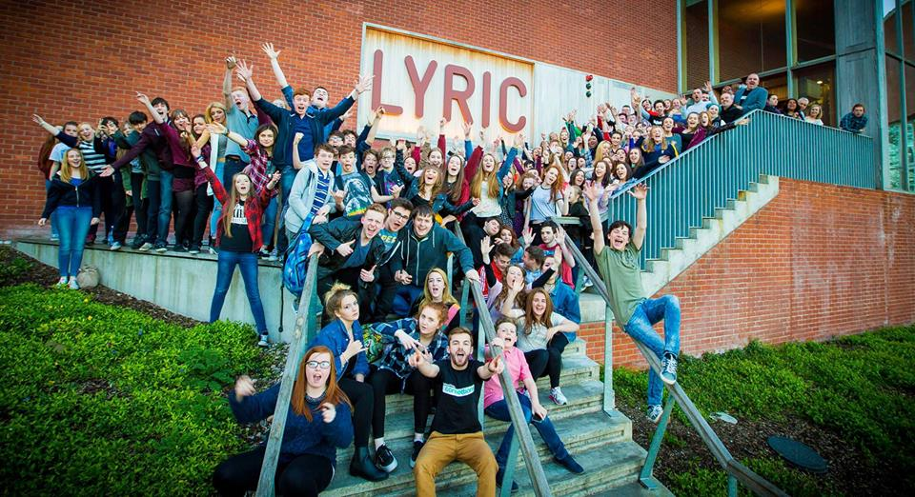
NT Connections Festival 2015 – Lyric Theatre Belfast
7 of the participating youth theatres were from Northern Ireland

Slide 10

1. How is youth theatre practice evolving in response to the changes we experience in theatre and in society?
Partnerships in Communities
Programme

Slide 11
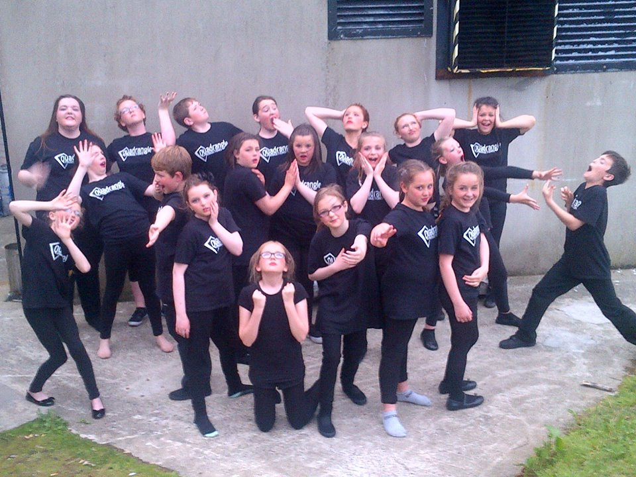
Quadrangle Productions
Volunteer-run
youth theatre
Ballycastle, County Antrim

Slide 12

2. Are young people changing? And how are they inspiring change in youth theatre?
Suitcase Theatre Roadshow

Slide 13
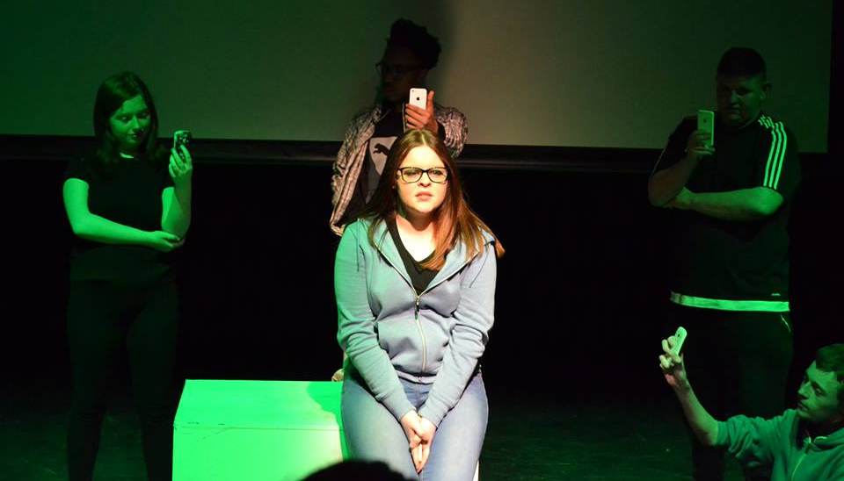
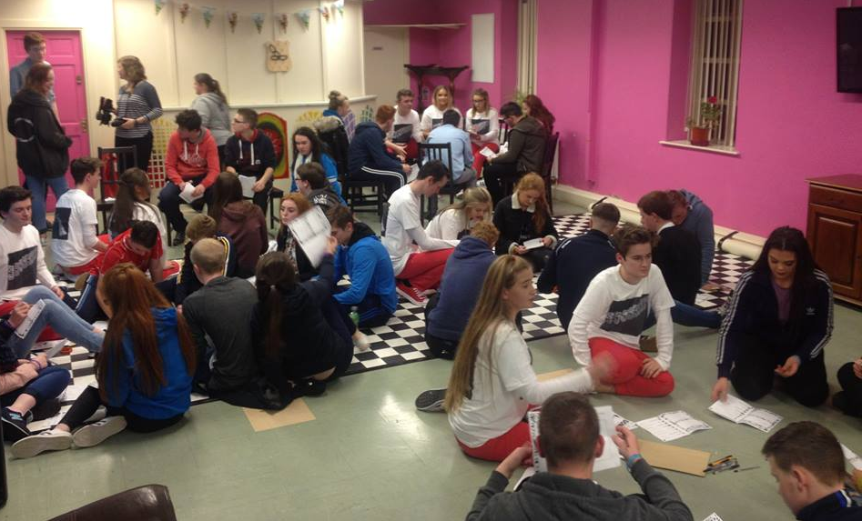
Performance on mental health
Post-show workshops

Slide 14
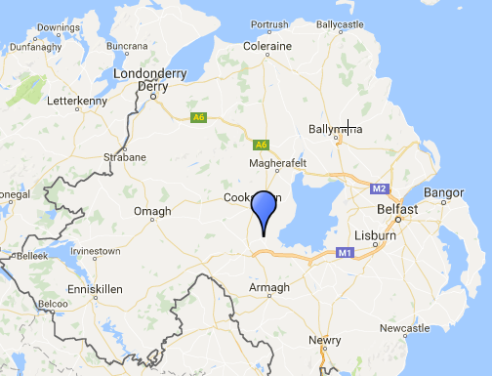

3. How does youth theatre practice empower young people to be changemakers in their lives and communities?
Coalisland
CRAIC Youth Theatre

Slide 15
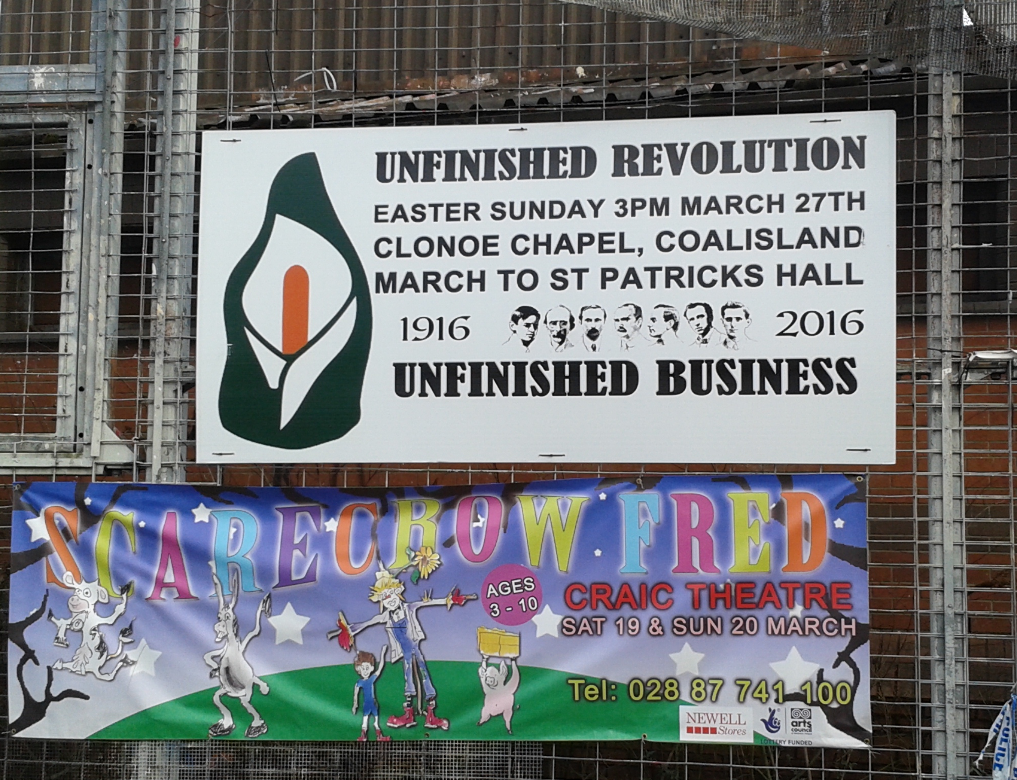
Posters
outside Coalisland Police Station
March 2016

Slide 16
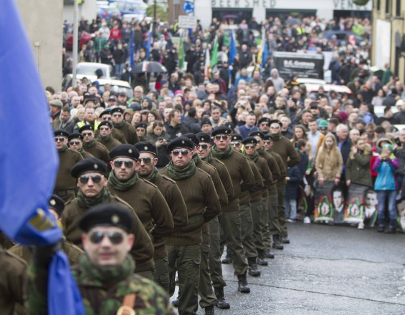
Easter Rising Commemoration,
Coalisland
March 2016

Slide 17
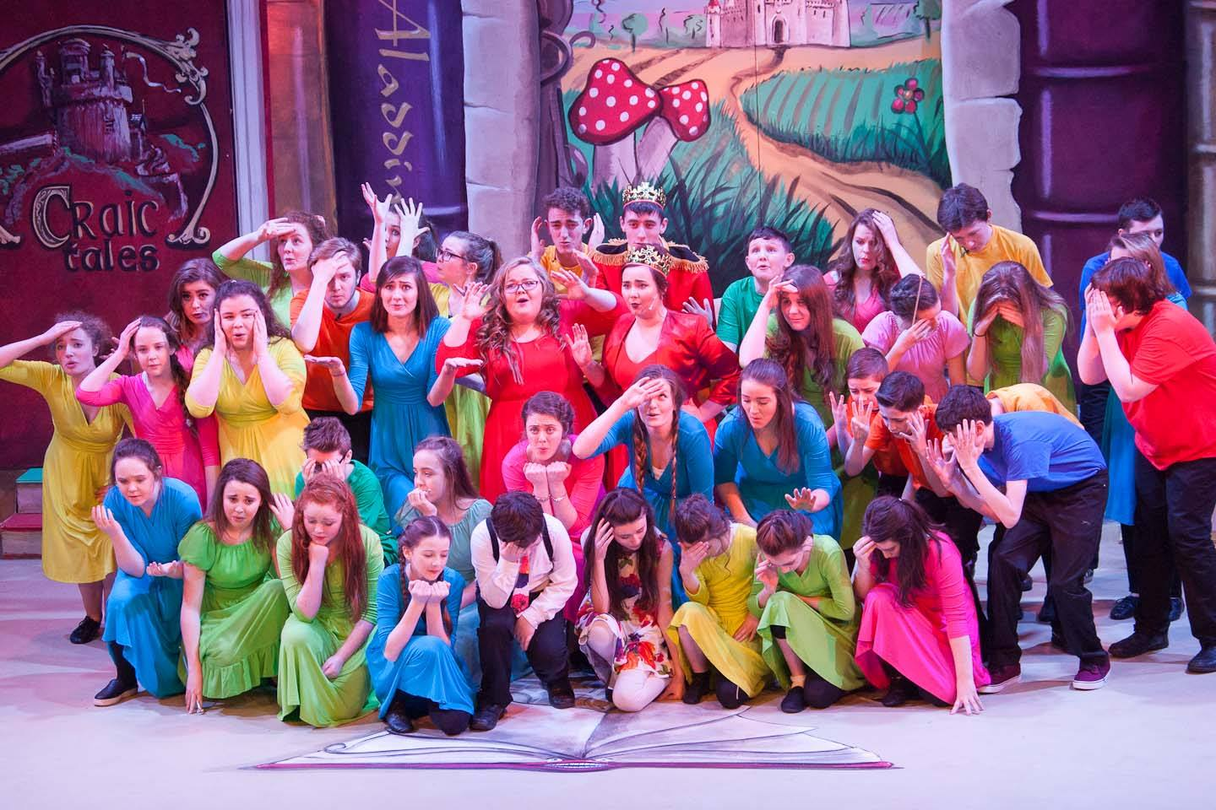
Craic Youth Theatre
Panto 2016
‘Once Upon
a Minion’

Slide 18
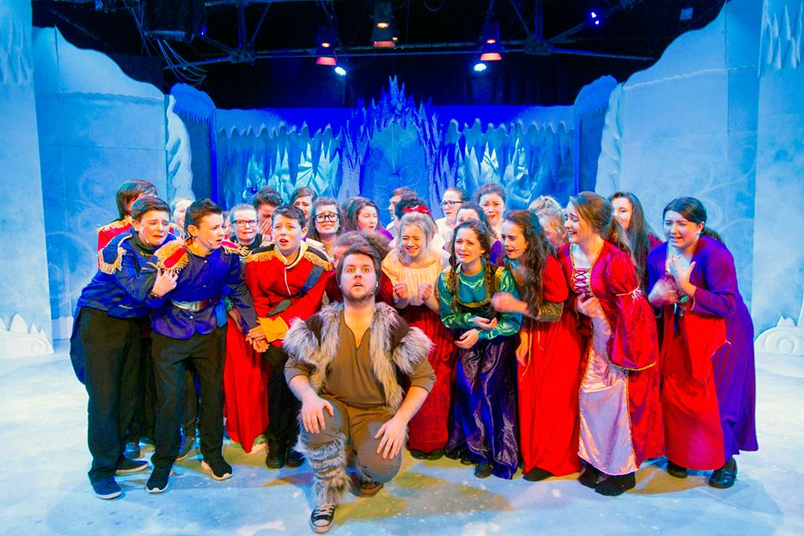
‘Foundered’
Craic Youth Theatre
Panto 2015
Emerging theme 2 b)
Youth theatre performances enriching the local community

Slide 19
'Foundered' promo video

